Slide 1


SPACE Y
Ivan Lam
4 December 2022

Slide 2
Outline
Executive Summary
Introduction
Methodology
Results
Conclusion
Appendix

Slide 3
Executive Summary
How can we predict if the Falcon 9 first stage will land?
Methodologies:
Data collection using public APIs and web scraping public web pages
Data wrangling
Exploratory data analysis
Interactive visual analytics using Folium and Plotly Dash
Predictive analysis using machine learning
Results:
Use visualization to identify features common to successful launches
Find most accurate machine learning algorithm

Slide 4
Introduction
Space Y is a newly formed rocket company
By analyzing publicly available data from our competitor, Space X, using data science and machine learning, we can identify features that are characteristic of a successful rocket launch
By focusing on these features, we can optimize the probability of success and minimize the cost of a launch, allowing us to make competitive bids

Slide 5

Section 1

Slide 6
Methodology
Executive Summary
Data collection methodology:
Data collected from SpaceX public API and web scraping relevant Wikipedia pages
Perform data wrangling
Filter to only include relevant data
Replace missing data with mean values
One-hot encoding to convert categorial columns to numerical columns
Perform exploratory data analysis (EDA) using visualization and SQL
Perform interactive visual analytics using Folium and Plotly Dash
Perform predictive analysis using classification models
Logistic Regression, SVM, Decision Tree and KNN models tested and accuracy determined

Slide 7
Data Collection
Rocket launch data obtained from the SpaceX API: https://api.spacexdata.com/v4/launches/past
Historical Falcon 9 and Falcon Heavy launch data obtained from Wikipedia: https://en.wikipedia.org/w/index.php?title=List_of_Falcon_9_and_Falcon_Heavy_launches&oldid=1027686922”

Slide 8
Data Collection – SpaceX API
Send GET request using requests Python library
SpaceX REST API returns response in JSON format
JSON data containing flight data converted to a pandas dataframe
Replace missing Payload Mass values with the mean Payload Mass
Data filtered to only contain Falcon 9 launches
GitHub URL of the completed SpaceX API calls notebook:
https://github.com/ictl/IBM-DS0720EN-Project/blob/master/Data%20Collection%20API%20Lab.ipynb

Slide 9
Data Collection – Web Scraping
Send GET request using requests Python library
Wikipedia web server returns HTML response
BeautifulSoup object created from HTML
Create pandas dataframe
Extract data from relevant table
GitHub URL of the completed web scraping notebook: https://github.com/ictl/IBM-DS0720EN-Project/blob/master/Data%20Collection%20with%20Web%20Scraping%20Lab.ipynb

Slide 10
Data Wrangling and EDA
Identify column types and any missing data
Calculate number of launches on each site
Calculate number and occurrence of each orbit
Convert Outcome column to Class using one-hot encoding
Replace missing Payload Mass values with the mean Payload Mass
Calculate number and occurrence of mission outcome per orbit type
GitHub URL of completed data wrangling notebook: https://github.com/ictl/IBM-DS0720EN-Project/blob/master/EDA%20Lab.ipynb

Slide 11
EDA with Data Visualization
Flight Number vs Payload Mass – scatter plot using seaborn catplot
Flight Number vs Launch Site – scatter plot using seaborn catplot
Payload Mass vs Launch Site – scatter plot using seaborn catplot
Orbit Type vs Success Rate – bar chart using pandas
Flight Number vs Orbit Type – scatter plot using seaborn catplot
Payload Mass vs Orbit Type – scatter plot using seaborn catplot
Year vs Success Rate – line graph using pandas
Completed EDA with data visualization notebook: https://github.com/ictl/IBM-DS0720EN-Project/blob/master/EDA%20with%20Visualization%20Lab.ipynb

Slide 12
EDA with SQL (1)
Find unique launch sites:
SELECT UNIQUE LAUNCH_SITE FROM SPACEX;
Find 5 records where launch site begins with ‘KSC’:
SELECT * FROM SPACEX WHERE LAUNCH_SITE LIKE 'KSC%' LIMIT 5;
Find total payload mass carried by boosters launched by NASA (CRS):
SELECT SUM(PAYLOAD_MASS__KG_) AS TOTAL_PAYLOAD_MASS FROM SPACEX WHERE CUSTOMER = 'NASA (CRS)’;
Find average payload mass carried by booster version F9 v1.1:
SELECT AVG(PAYLOAD_MASS__KG_) AS AVERAGE_PAYLOAD_MASS FROM SPACEX WHERE BOOSTER_VERSION = 'F9 v1.1';

Slide 13
EDA with SQL (2)
Find the date where the first successful landing outcome in drone ship was achieved:
SELECT DATE FROM SPACEX WHERE DATE = (SELECT MIN(DATE) FROM SPACEX);
Find names of the boosters which have success in ground pad and have payload mass greater than 4000 but less than 6000
SELECT UNIQUE BOOSTER_VERSION FROM SPACEX WHERE LANDING__OUTCOME = 'Success (ground pad)' AND PAYLOAD_MASS__KG_ BETWEEN 4000 AND 6000;
Find total number of successful and failure mission outcomes:
SELECT MISSION_OUTCOME, COUNT(MISSION_OUTCOME) AS TOTAL FROM SPACEX GROUP BY MISSION_OUTCOME;
Find names of the booster versions which have carried the maximum payload mass:
SELECT UNIQUE BOOSTER_VERSION FROM SPACEX WHERE PAYLOAD_MASS__KG_ = (SELECT MAX(PAYLOAD_MASS__KG_) FROM SPACEX);

Slide 14
EDA with SQL (3)
Find records which will display the month names, succesful landing_outcomes in ground pad ,booster versions, launch_site for the months in year 2017:
SELECT MONTHNAME(DATE) AS MONTH, LANDING__OUTCOME, BOOSTER_VERSION, LAUNCH_SITE FROM SPACEX WHERE LANDING__OUTCOME = 'Success (ground pad)' AND DATE LIKE '2017%';
Rank the count of successful landing_outcomes between the date 2010-06-04 and 2017-03-20 in descending order.:
SELECT LANDING__OUTCOME, COUNT(LANDING__OUTCOME) AS SUCCESSFUL_LANDING_OUTCOMES FROM SPACEX WHERE LANDING__OUTCOME LIKE 'Success%' AND DATE BETWEEN '2010-06-04' AND '2017-03-20' GROUP BY LANDING__OUTCOME ORDER BY SUCCESSFUL_LANDING_OUTCOMES DESC;
GitHub URL of completed EDA with SQL notebook: https://github.com/ictl/IBM-DS0720EN-Project/blob/master/EDA%20with%20SQL%20Lab.ipynb

Slide 15
Build an Interactive Map with Folium
Folium markers and circles added to identify launch sites
Marker cluster added to identify successful launches, many of which will have the same coordinate
Markers and lines added to show the distance between a launch site and the nearest highway and railroad routes which materials can be delivered to the launch site
Markers and lines added to show the distance between a launch site and the nearest coastline and city – areas where a rocket could potentially land if launch not successful
GitHub URL of completed interactive map with Folium map: https://github.com/ictl/IBM-DS0720EN-Project/blob/master/Interactive%20Visual%20Analytics%20with%20Folium%20Lab.ipynb
Folium maps do not display in Jupyter notebooks uploaded to GitHub; the original file in IBM Watson can be found here: https://eu-gb.dataplatform.cloud.ibm.com/analytics/notebooks/v2/40c96d89-cc44-4e9a-88e7-cbabbbea7e70/view?access_token=5f146469b875b526f4370d145d310dbf4df7cc321ef3bda12ababde630a2ea83

Slide 16
Build a Dashboard with Plotly Dash
Plotly dashboard contained a pie chart showing the proportion of successful launches by site
Dropdown menu allows focusing the pie chart to show the success rate of a particular site
Scatter plot showing correlation of payload and success rate for different boosters and launch sites
Payload range slider allows focusing the scatter plot to a particular range of payload mass
GitHub URL of completed Plotly Dash lab: https://github.com/ictl/IBM-DS0720EN-Project/blob/master/spacex_dash_app.py

Slide 17
Predictive Analysis (Classification)
Obtain data and create pandas dataframe
Create NumPy array containing the column of the variable we wish to predict
Perform preprocessing and standardize original dataframe
Determine the accuracy of each algorithm and select best performing algorithm
Train and then test different classification algorithms
Split data into testing and training data
Algorithms tested: Logistic Regression (LR), Support Vector Machine (SVM), Decision Tree, K-Nearest Neighbor (KNN)
GitHub URL of completed predictive analysis lab: https://github.com/ictl/IBM-DS0720EN-Project/blob/master/Machine%20Learning%20Prediction%20Lab.ipynb

Slide 18
Results
Exploratory data analysis results
Interactive analytics demo in screenshots
Predictive analysis results

Slide 19

Section 2

Slide 20
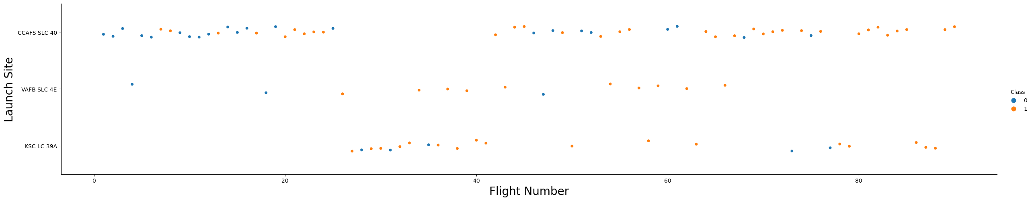
Flight Number vs. Launch Site
Higher flight numbers represent more recent launches
The most recent flight launches are more likely to be successful and launched from CCAPS SLC 40 or KSC LC 39A

Slide 21
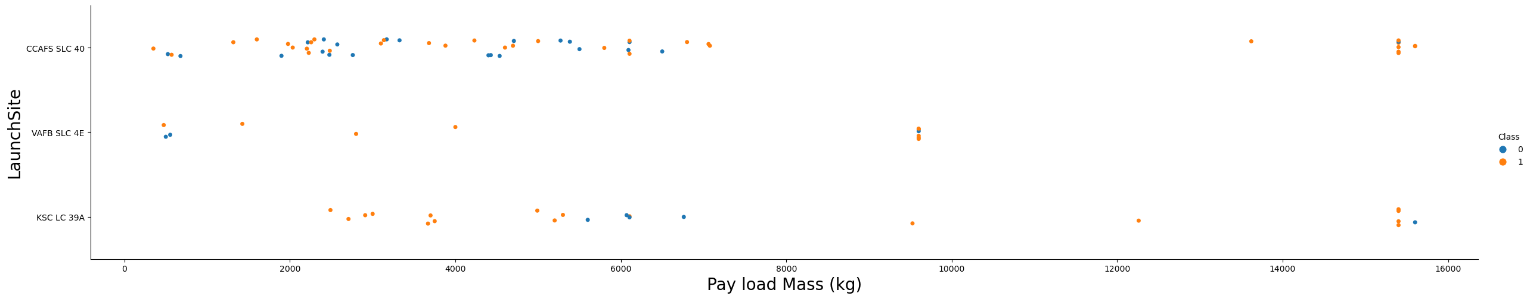
Payload vs. Launch Site
Higher payload mass is more likely to result in a successful launch
There are no launches at VAFB SLC 4E with payload mass > 10,000 kg. It may be the case that this launch site is not capable of supporting such a high payload mass

Slide 22
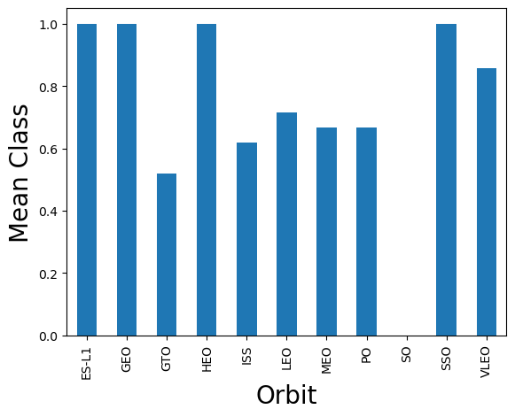
Success Rate vs. Orbit Type
ES-L1, GEO, HEO and SSO have the highest success rate
Orbits which have a low altitude tend to have a lower success rate, with the exception of VLEO and GTO
Limited conclusions can be drawn from this graph alone, as number of launches and date of launches are not represented

Slide 23
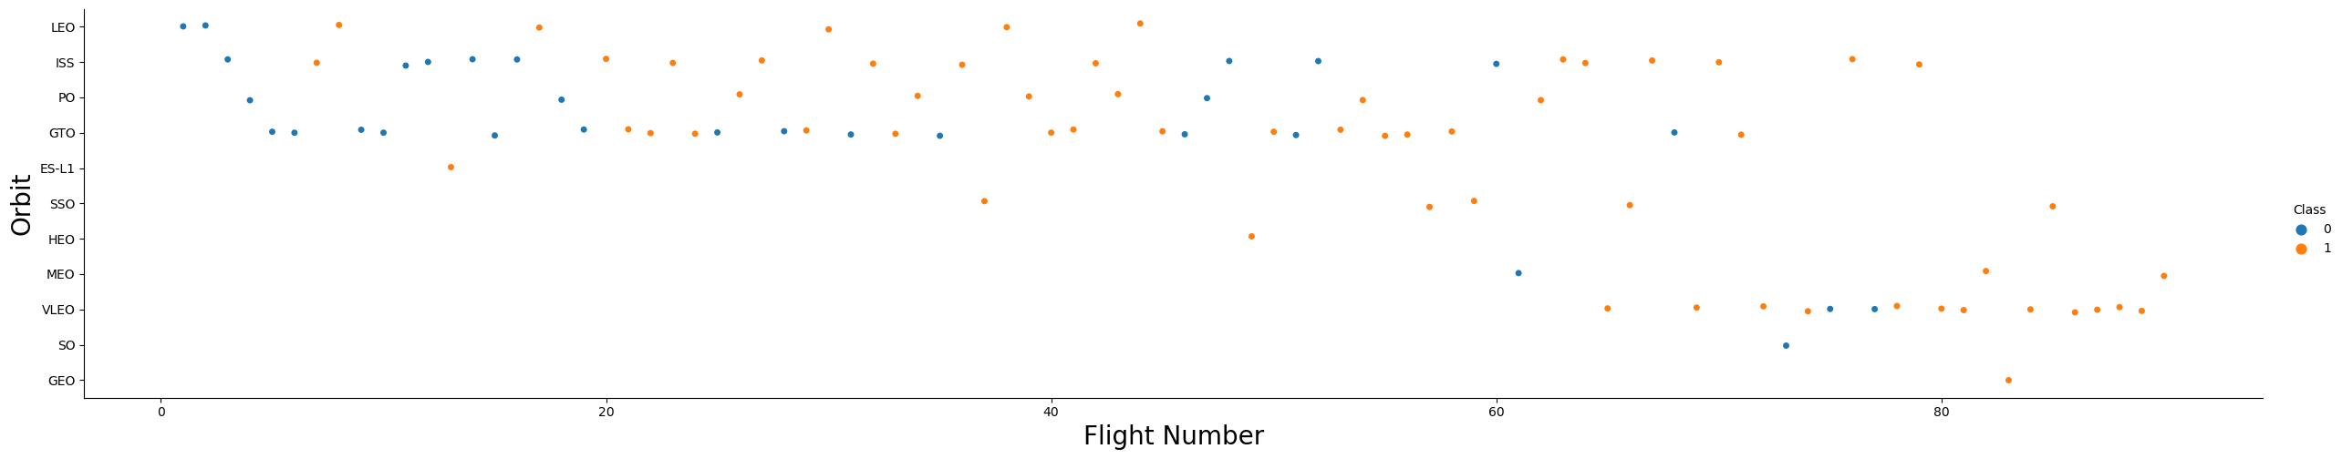
Flight Number vs. Orbit Type
More recent flights tend to have an orbit type of VLEO, which has a very low altitude
Recent technological advances improve the success rate of lower altitude orbits
Low altitude orbits allow more effective observation from Earth and are therefore more useful

Slide 24
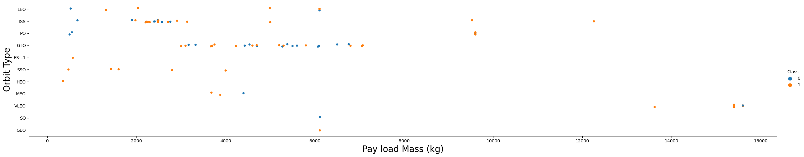
Payload vs. Orbit Type
The highest payload masses are used in the VLEO orbit type
VLEO has a very low altitude – orbit types with a higher altitude may be more difficult to achieve with a very high payload mass

Slide 25
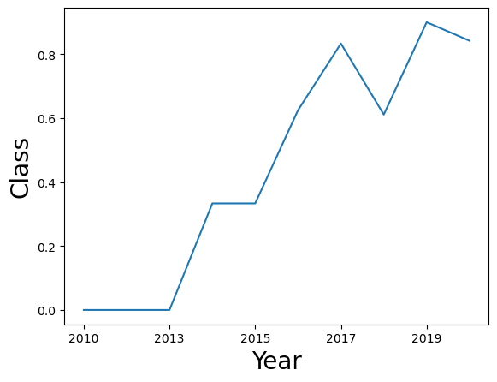
Launch Success Yearly Trend
The success rate generally increased year-on-year from 2013 to 2020

Slide 26
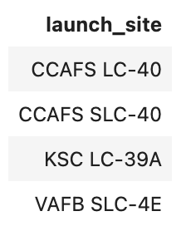
All Launch Site Names
SELECT UNIQUE LAUNCH_SITE FROM SPACEX;
Use of ‘UNIQUE’ returns only unique results, removing any duplicates

Slide 27
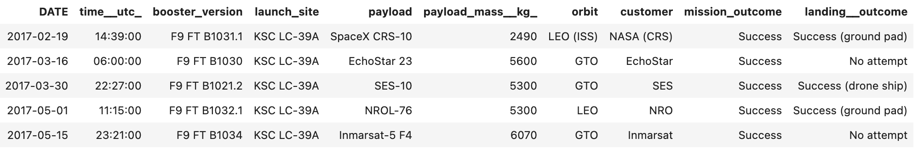
Launch Site Names Begin with 'KSC'
SELECT * FROM SPACEX WHERE LAUNCH_SITE LIKE 'KSC%' LIMIT 5;
‘LIKE ‘KSC%’’ will search for string beginning with ‘KSC’, as % is a wildcard character
‘LIMIT 5’ restricts number of records returned to 5.

Slide 28
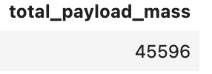
Total Payload Mass
SELECT SUM(PAYLOAD_MASS__KG_) AS TOTAL_PAYLOAD_MASS FROM SPACEX WHERE CUSTOMER = 'NASA (CRS)';
Result: 45596 kg
‘SUM(PAYLOAD_MASS__KG)’ calculates total payload mass
‘WHERE CUSTOMER = ‘NASA (CRS)’ filters to only include NASA (CRS)

Slide 29
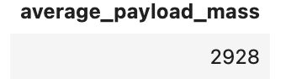
Average Payload Mass by F9 v1.1
SELECT AVG(PAYLOAD_MASS__KG_) AS AVERAGE_PAYLOAD_MASS FROM SPACEX WHERE BOOSTER_VERSION = 'F9 v1.1';
Result: 2928 kg
‘AVG(PAYLOAD_MASS__KG)’ calculates average payload mass
‘WHERE BOOSTER_VERSION = ‘F9 v1.1’ filters to only include booster version F9 v1.1

Slide 30
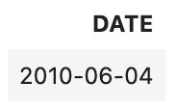
First Successful Ground Landing Date
SELECT DATE FROM SPACEX WHERE DATE = (SELECT MIN(DATE) FROM SPACEX);
Result: 2010-06-04
‘SELECT MIN(DATE) FROM SPACEX’ finds the lowest (i.e. earliest) date

Slide 31
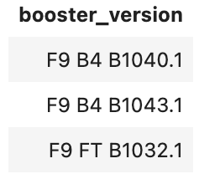
Successful Drone Ship Landing with Payload between 4000 and 6000
SELECT UNIQUE BOOSTER_VERSION FROM SPACEX WHERE LANDING__OUTCOME = 'Success (ground pad)' AND PAYLOAD_MASS__KG_ BETWEEN 4000 AND 6000;
‘AND’ used to only return results matching both conditions
‘PAYLOAD_MASS__KG_ BETWEEN 4000 AND 6000’ used to find payload mass greater than 4000 but less than 6000

Slide 32
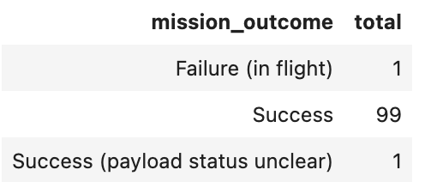
Total Number of Successful and Failure Mission Outcomes
SELECT MISSION_OUTCOME, COUNT(MISSION_OUTCOME) AS TOTAL FROM SPACEX GROUP BY MISSION_OUTCOME;
‘COUNT(MISSION_OUTCOME)’ when combined with ‘GROUP BY MISSION_OUTCOME’ returns the number of occurrences of each unique value in MISSION_OUTCOME

Slide 33
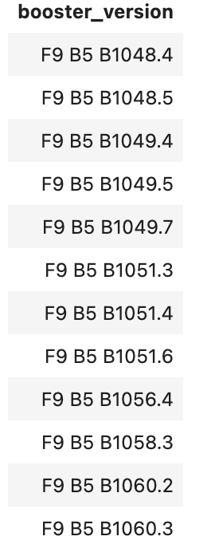
Boosters Carried Maximum Payload
SELECT UNIQUE BOOSTER_VERSION FROM SPACEX WHERE PAYLOAD_MASS__KG_ = (SELECT MAX(PAYLOAD_MASS__KG_) FROM SPACEX);
‘SELECT UNIQUE BOOSTER_VERSION FROM SPACEX’ returns only unique booster versions, removing any duplicates
‘SELECT MAX(PAYLOAD_MASS__KG_) FROM SPACEX’ finds the maximum payload mass
Subquery is used to link the two statements together

Slide 34
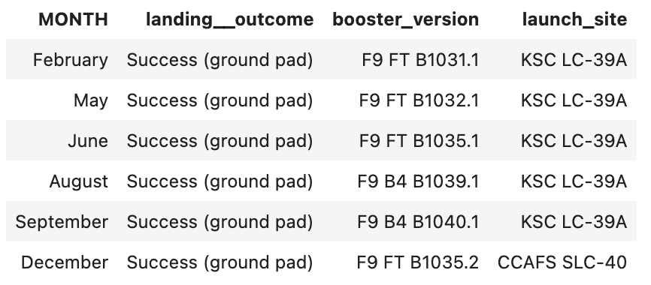
2017 Launch Records
SELECT MONTHNAME(DATE) AS MONTH, LANDING__OUTCOME, BOOSTER_VERSION, LAUNCH_SITE FROM SPACEX WHERE LANDING__OUTCOME = 'Success (ground pad)' AND DATE LIKE '2017%';
‘MONTHNAME(DATE)’ returns the month name for the given date
‘LANDING__OUTCOME = 'Success (ground pad)’ ’ returns results only where the landing outcome is successful on the ground pad
‘DATE LIKE '2017%'’ returns results only where the date begins with ‘2017’ (i.e. year is 2017)

Slide 35
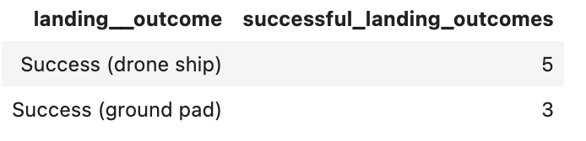
Rank Landing Outcomes Between 2010-06-04 and 2017-03-20
SELECT LANDING__OUTCOME, COUNT(LANDING__OUTCOME) AS SUCCESSFUL_LANDING_OUTCOMES FROM SPACEX WHERE LANDING__OUTCOME LIKE 'Success%' AND DATE BETWEEN '2010-06-04' AND '2017-03-20' GROUP BY LANDING__OUTCOME ORDER BY SUCCESSFUL_LANDING_OUTCOMES DESC;
‘COUNT(LANDING__OUTCOME)’ when combined with ‘GROUP BY LANDING__OUTCOME’ returns the number of occurrences of each unique value in LANDING__OUTCOME
‘LANDING__OUTCOME LIKE 'Success%'’ returns results where LANDING__OUTCOME begins with ‘Success’.
‘DATE BETWEEN '2010-06-04' AND '2017-03-20' ’ returns results between the two dates
‘ORDER BY SUCCESSFUL_LANDING_OUTCOMES DESC’ orders in descending order

Slide 36

Section 3

Slide 37
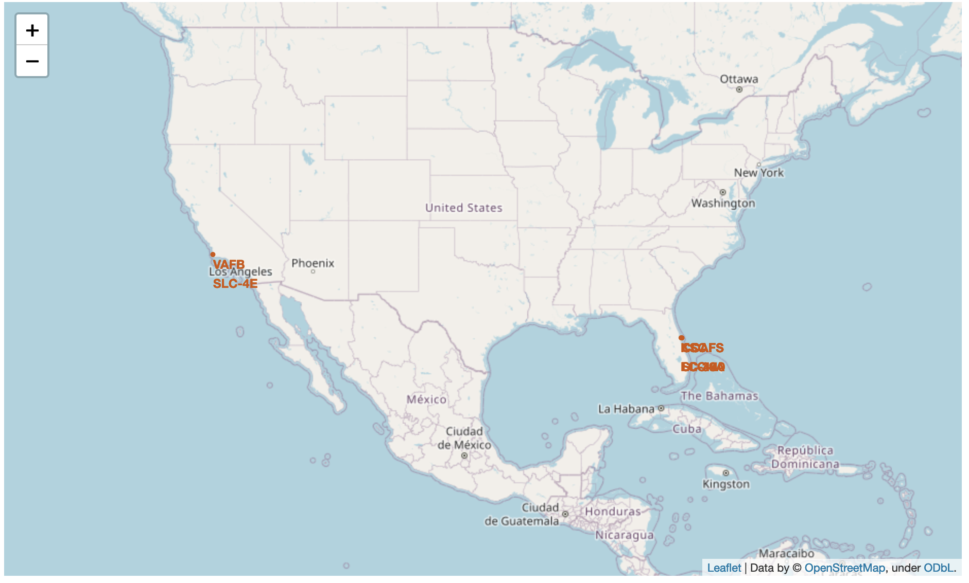
Location of Launch Sites
Launch sites are close to the sea
If a rocket launch fails, it will be more likely to land in the sea than on land, where it may cause damage to buildings etc.

Slide 38
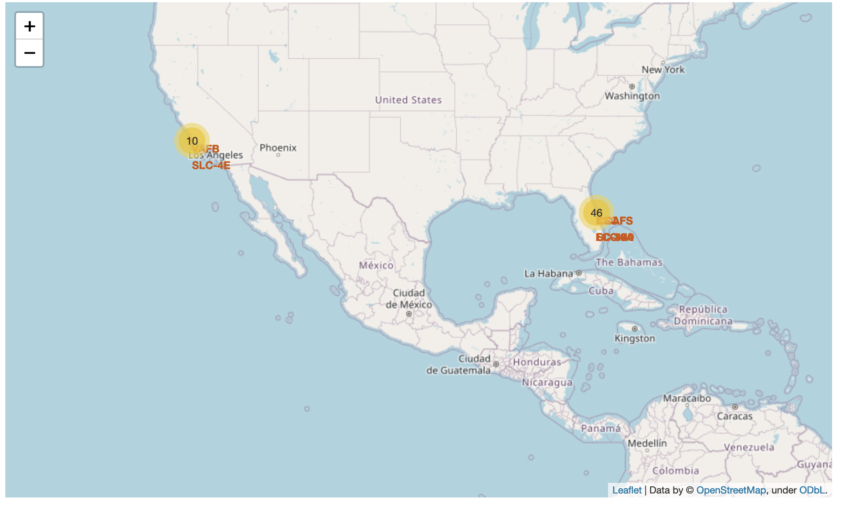
Number of launches per location
Most launches took place on the East coast, rather than the West coast

Slide 39
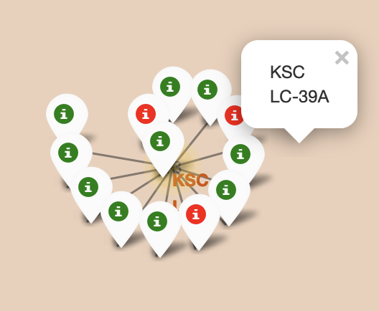
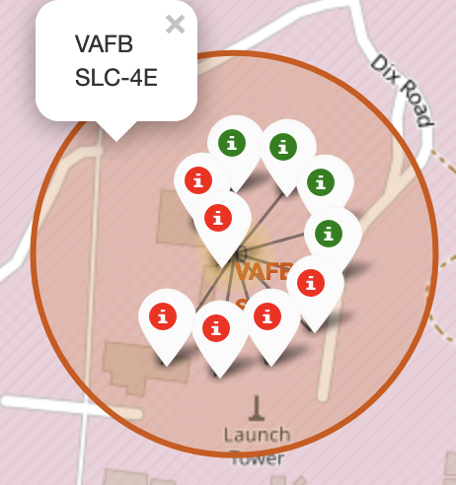
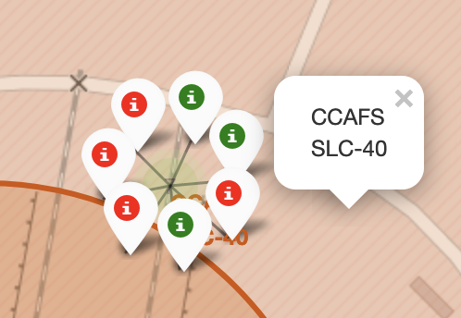
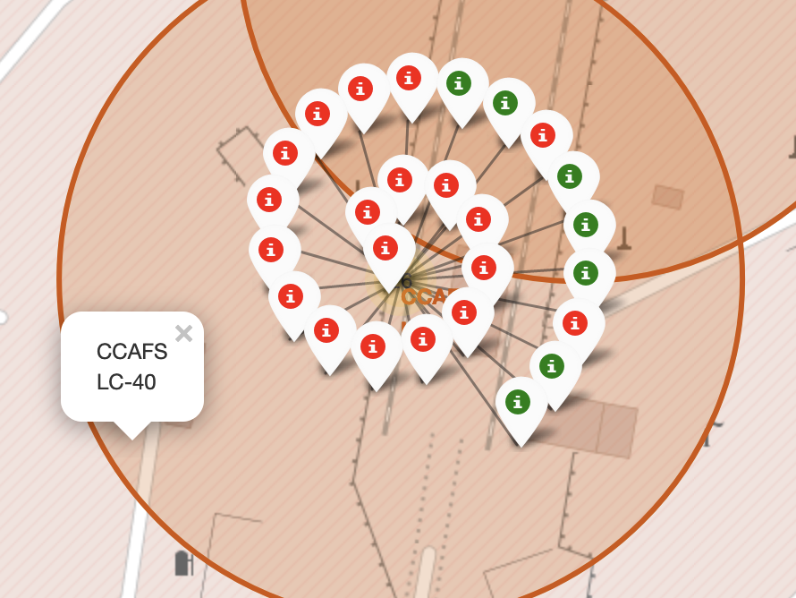
Launch success rate per location
KSC LC-39A has the highest success rate of the four launch sites

Slide 40
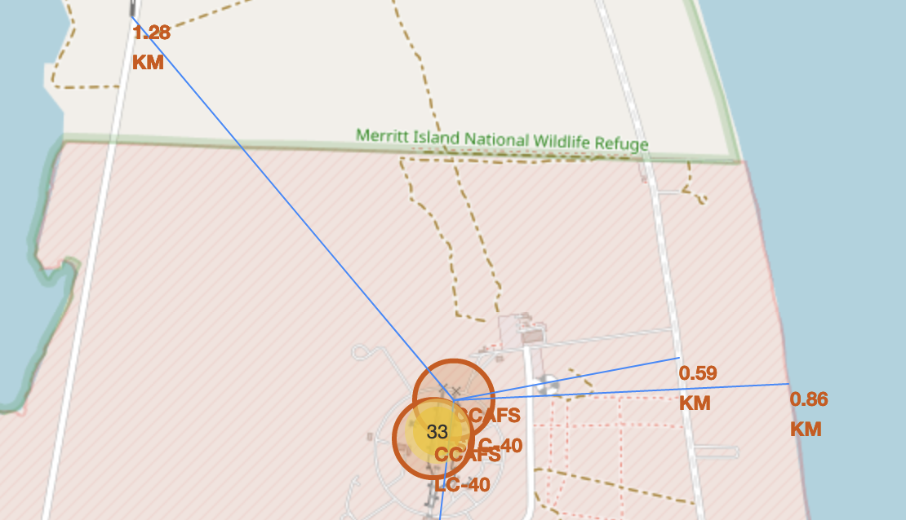
Distance between launch sites and points of interest
Launch sites are close to highways and railroads
Allows easy delivery of heavy materials
Launch sites are close to the coastline
Rockets more likely to fall into the ocean, causing less damage

Slide 41
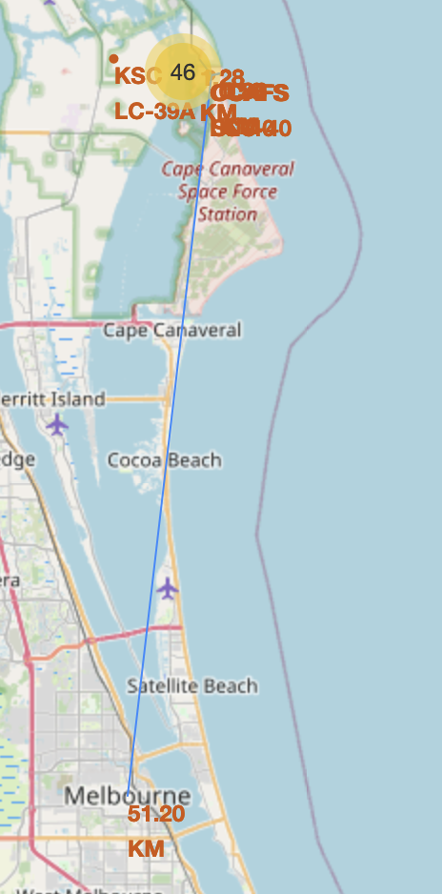
Distance between launch sites and points of interest
Launch sites are far away from other cities
Rockets less likely to land in cities if they are further away, minimizing potential damage

Slide 42

Section 4

Slide 43
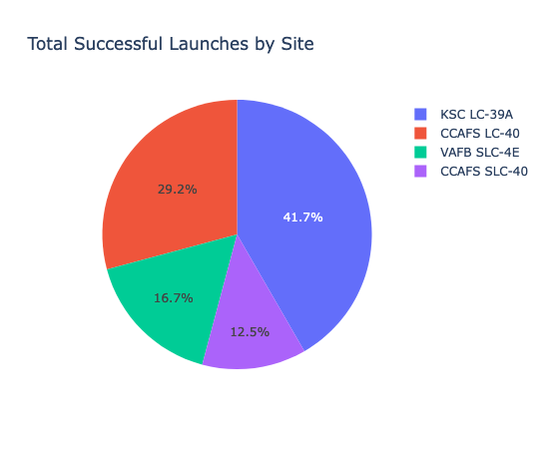
Total Successful Launches by Site
The majority of successful launches were from the KSC LC-39A site

Slide 44
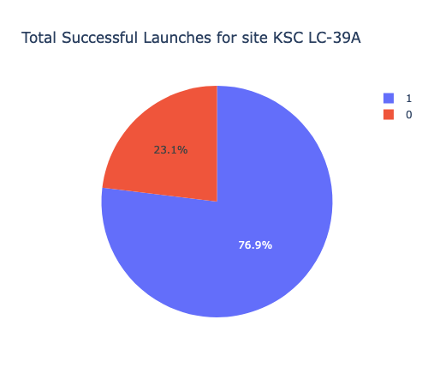
Total Successful Launches for Site KSC LC-39
The majority of launches from site KSC LC-39A were successful (76.9%)

Slide 45
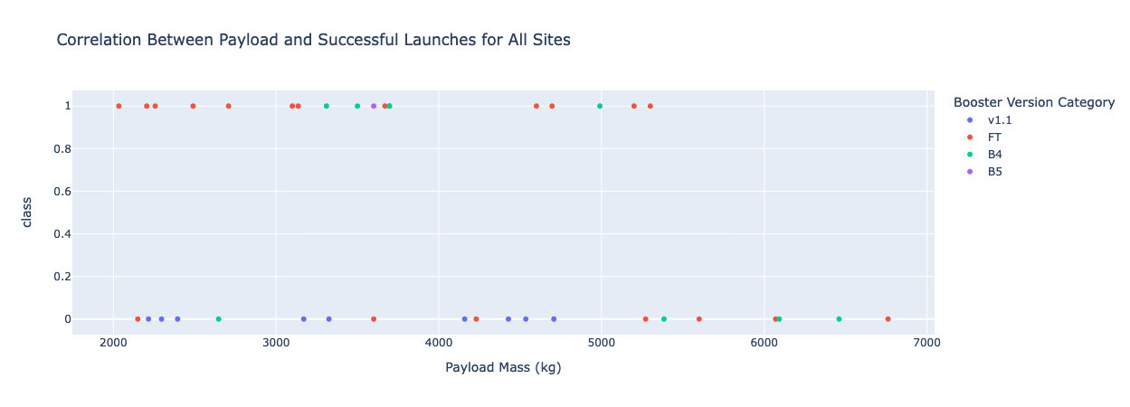
Payload vs Success Rate for Payload between 2000 and 7000 kg
Booster v1.1 had the lowest success rate
Booster FT had the highest success rate when payload mass < 5300 kg but not between 3800 and 4300 kg
Success rate for all boosters with payload mass between 5300 and 7000 kg was 0.

Slide 46

Section 5

Slide 47
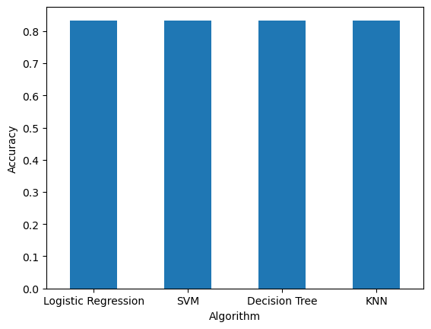
Classification Accuracy
4 algorithms were trained, tested and evaluated
Logistic Regression (LR)
Support Vector Machine (SVM)
Decision Tree
K-Nearest Neighbour (KNN)
All 4 algorithms had the same accuracy (83.33%)

Slide 48
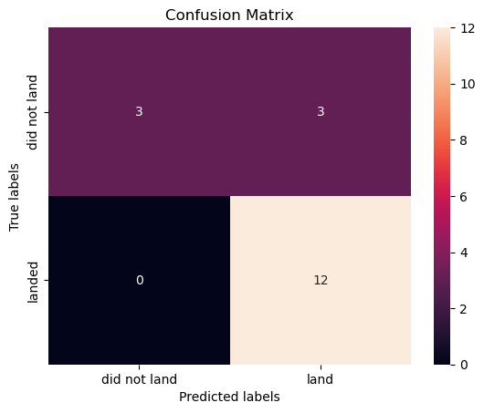
Confusion Matrix
Confusion matrix for all 4 algorithms was the same
All algorithms predicted successful landings well, but were less accurate at predicting unsuccessful landings

Slide 49
Conclusions
Purely from visual EDA, the following characteristics appear to be more likely to result in a successful launch:
From the KSC LC-39A launch site
Using VLEO orbit
Using payload mass of ~15,000 kg
Machine learning should be used to predict success rate as it can take into account multiple variables
All 4 machine learning algorithms tested (LR, SVM, Decision Tree, KNN) had the same accuracy
All 4 algorithms can be used to predict if the launch will be successful, however, they may predict some false positives
If we can maximize the success rate, we can reduce the cost of launches and make more competitive bids

Slide 50
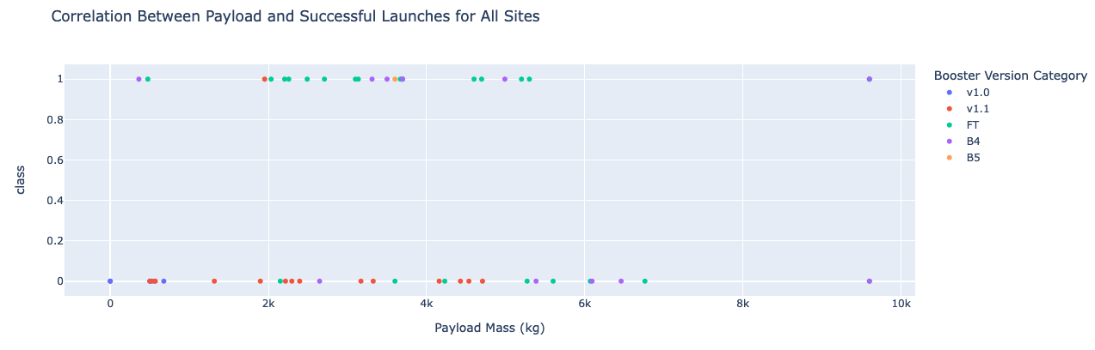
Appendix
GitHub repository: https://github.com/ictl/IBM-DS0720EN-Project
Payload Mass vs Success Rate for all sites and payload mass between 0 and 10,000 kg:

Slide 51


